Slide 1
ING
SonarQube-Rule-Customization
By
Prashant Gaikwad/Mahendran S
July 16, 2020
1

Slide 2
Overview of SonarQube
SonarQube (formerly Sonar)[2] is an open-source platform developed by SonarSource for continuous inspection of code quality to perform automatic reviews with static analysis of code to detect bugs, code smells, and security vulnerabilities on 20+ programming languages. SonarQube offers reports on duplicated code, coding standards, unit tests, code coverage, code complexity, comments, bugs, and security vulnerabilities.
SonarQube can record metrics history and provides evolution graphs. SonarQube provides fully automated analysis and integration with Maven, Ant, Gradle, MSBuild and continuous integration tools (Atlassian Bamboo, Jenkins, Hudson, etc.).
SonarQube integrates with Eclipse, Visual Studio, and IntelliJ IDEA development environments through the SonarLint plug-ins, and also integrates with external tools like LDAP, Active Directory, GitHub, and others. SonarQube is expandable with the use of plug-ins.

Slide 3
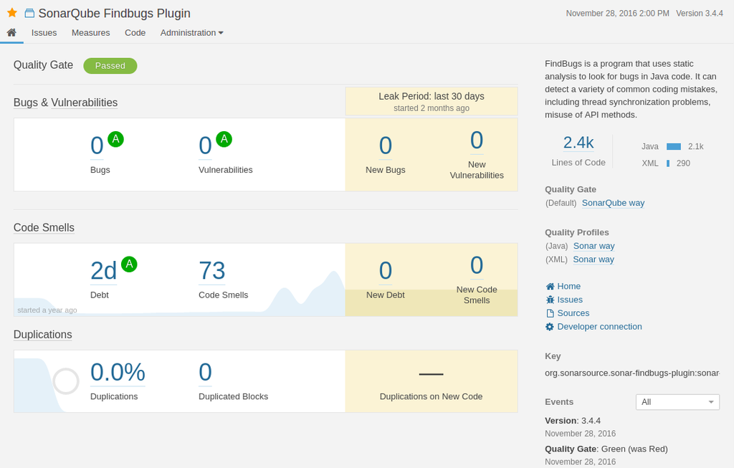
Overview of SonarQube

Slide 4
Learn Ansible Fundamentals and Linux
Discovered issues can either be a Bug, Vulnerability, Code Smell, Coverage or Duplication. Each category has a corresponding number of issues or a percentage value.
Moreover, issues can have one of five different severity levels: blocker, critical, major, minor and info. Just in front of the project name is an icon that displays the Quality Gate status – passed (green) or failed (red).
Clicking on the project name will take us to a dedicated dashboard where we can explore issues particular to the project in greater detail.
We can see the project code, activity and perform administration tasks from the project dashboard – each available on a separate tab.
Though there is a global Issues tab, the Issues tab on the project dashboard display issues specific to the project concerned alone:

Slide 5
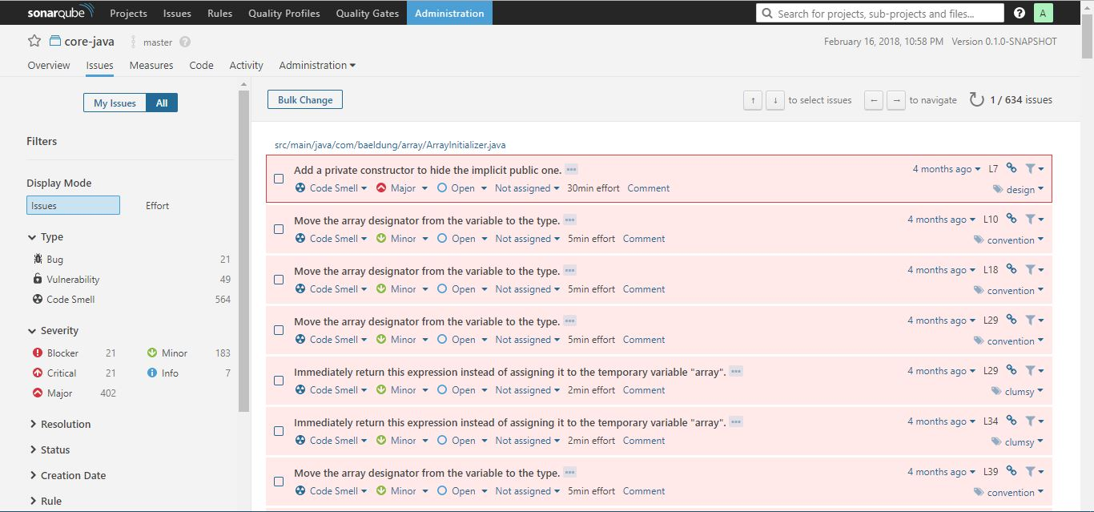
Overview of SonarQube

Slide 6
Learn Ansible Fundamentals and Linux
The issues tab always display the category, severity level, tag(s), and the calculated effort (regarding time) it will take to rectify an issue.
From the issues tab, it's possible to assign an issue to another user, comment on it, and change its severity level. Clicking on the issue itself will show more detail about the issue.
The issue tab comes with sophisticated filters to the left. These are good for pinpointing issues. So how can one know if the codebase is healthy enough for deployment into production? That's what Quality Gate is for.

Slide 7
SonarQube Quality Gate
A Quality Gate is a set of conditions the project must meet before it can qualify for production release. It answers one question: can I push my code to production in its current state or not?
Ensuring code quality of “new” code while fixing existing ones is one good way to maintain a good codebase over time. The Quality Gate facilitates setting up rules for validating every new code added to the codebase on subsequent analysis.
The conditions set in the Quality Gate still affect unmodified code segments. If we can prevent new issues arising, over time, we'll eliminate all issues.
This approach is comparable to fixing the water leakage from the source. This brings us to a particular term – Leakage Period. This is the period between two analyses/versions of the project.
If we rerun the analysis, on the same project, the overview tab of the project dashboard will show results for the leak period:
The default configuration for SonarQube way flags the code as failed if:
the coverage on new code is less than 80%
percentage of duplicated lines on new code is greater than 3
maintainability, reliability or security rating is worse than A
With this understanding, we can create a custom Quality Gate.

Slide 8
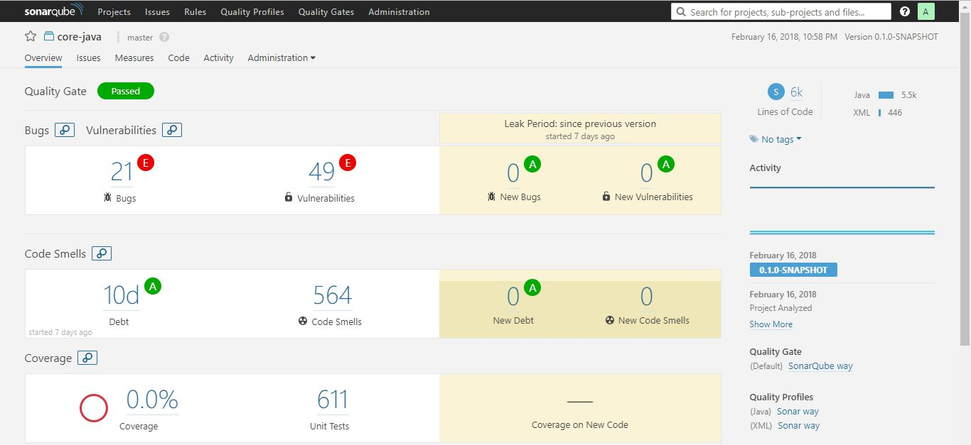
Overview of SonarQube

Slide 9
Adding Custom Quality Gate
Fully integrated with DevOps tool chains it comes with:
built-in integration with most build tools, which enables in most cases a no configuration approach
easy integration with continuous integration engines such as Jenkins, Azure DevOps, TeamCity, Bamboo,…
support for numerous source configuration management tools such as Git, Subversion, CVS, Mercurial, …

Slide 10
Adding Custom Quality Gate
One final step, we need to attach a project to our custom Quality Gate. We can do so by scrolling down the page to the Projects section.
There we need to click on All and then mark our project of choice. We can as well set it as the default Quality Gate from the top-right corner of the page.
We'll scan the project source code, again, as we did before with Maven command. When that's done, we'll go to the projects tab and refresh.
This time, the project will not meet the Quality Gate criteria and will fail. Why? Because in one of our rules we have specified that, it should fail if there are no new issues.
Let's go back to the Quality Gates tab and change the condition for issues to is greater than. We need to click the update button to effect this change.
A new scan of the source code will pass this time around.

Slide 11
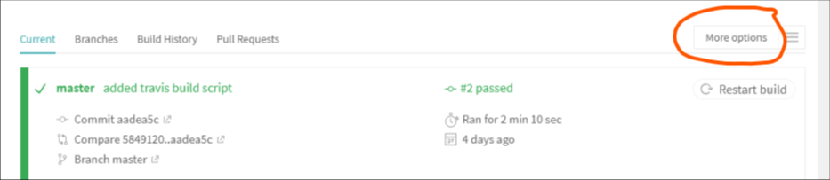
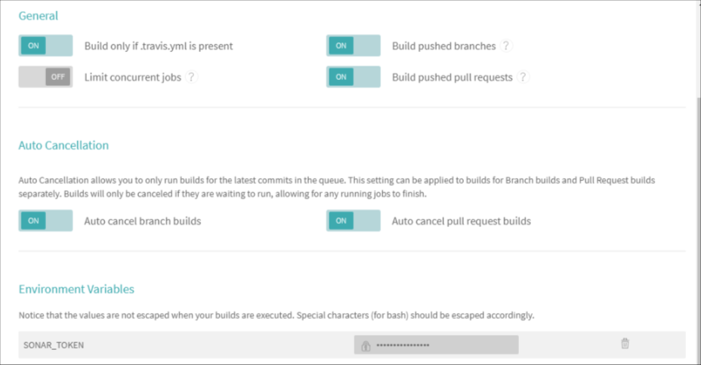
Adding Custom Quality Gate

Slide 12
Integrating SonarQube into a CI
Making SonarQube part of a Continuous Integration process is possible. This will automatically fail the build if the code analysis did not satisfy the Quality Gate condition.
For us to achieve this, we're going to be using SonarCloud which is the cloud-hosted version of SonaQube server. We can create an account here.
From My Account > Organizations, we can see the organization key, and it will usually be in the form xxxx-github or xxxx-bitbucket.
Also from My Account > Security, we can generate a token as we did in the local instance of the server. Take note of both the token and the organization key for later use.
In this article, we'll be using Travis CI, and we'll create an account here with an existing Github profile. It will load all our projects, and we can flip the switch on any to activate Travis CI on it.
We need to add the token we generated on SonarCloud to Travis environment variables. We can do this by clicking on the project we've activated for CI.
Then, we'll click “More Options” > “Settings” and then scroll down to “Environment Variables”:
We'll add a new entry with the name SONAR_TOKEN and use the token generated, on SonarCloud, as the value. Travis CI will encrypt and hide it from public view:

Slide 13
Learn Ansible Fundamentals and Linux
Fully integrated with DevOps tool chains it comes with:
built-in integration with most build tools, which enables in most cases a no configuration approach
easy integration with continuous integration engines such as Jenkins, Azure DevOps, TeamCity, Bamboo,…
support for numerous source configuration management tools such as Git, Subversion, CVS, Mercurial, …

Slide 14
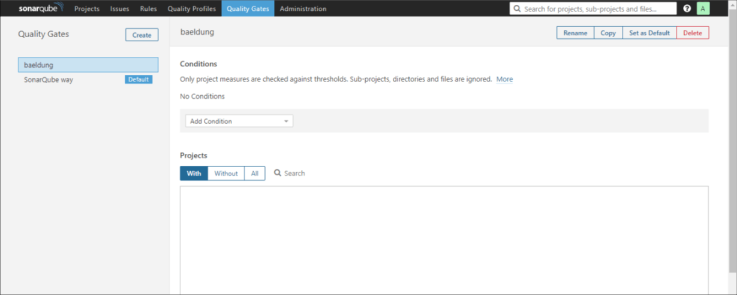
Adding Custom Quality Gate

Slide 15
why analyze source code in the first place?
Finally, we need to add a .travis.yml file to the root of our project with the following content:
 | language: java
 | sudo: false
 | install: true
 | addons:
 | sonarcloud:
 | organization: "your_organization_key"
 | token:
 | secure: "$SONAR_TOKEN"
 | jdk:
 | - oraclejdk8
 | script:
 | - mvn clean org.jacoco:jacoco-maven-plugin:prepare-agent package sonar:sonar
 | cache:
 | directories:
 | - '$HOME/.m2/repository'
 | - '$HOME/.sonar/cache'

Slide 16
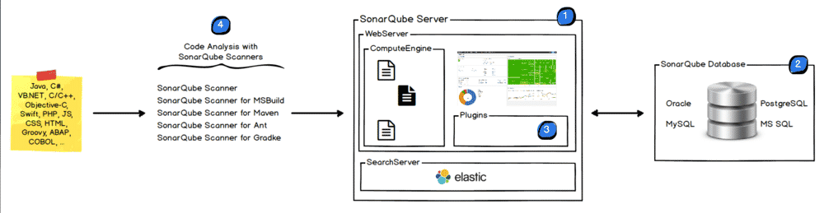
How Sonar Works ?

Slide 17
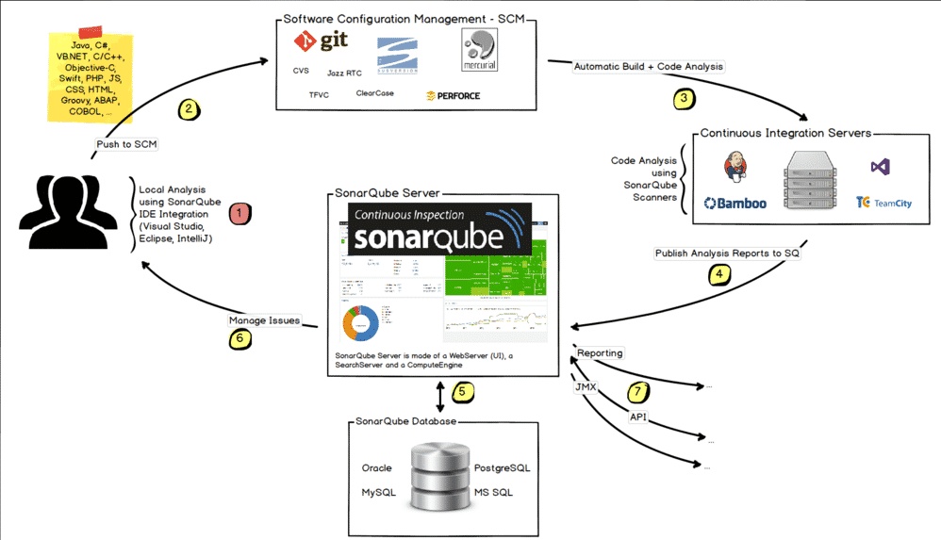
Sonar CI:

Slide 18
SonarQube Features:
upports languages: Java, C/C++, Objective-C, C#, PHP, Flex, Groovy, JavaScript, Python, PL/SQL, COBOL, etc. (note that some of them are commercial)
Can also be used in Android development.
Offers reports on duplicated code, coding standards, unit tests, code coverage, code complexity, potential bugs,comments and design and architecture.
Records metrics history and provides evolution graphs (“time machine”) and differential views.
Provides fully automated analyses: integrates with Maven, Ant, Gradle and continuous integration tools (Atlassian Bamboo, Jenkins, Hudson, etc.).
Integrates with the Eclipse development environment
Integrates with external tools: JIRA, Mantis, LDAP, Fortify, etc.
Is expandable with the use of plugins.
Implements the SQALE methodology to compute technical debt. (wiki)

Slide 19
How Sonar Works ?
Sonar uses various static & dynamic code analysis tools such as Checkstyle, PMD, FindBugs , FxCop , Gendarme and many more to extract software metrics, which then can be used to improve software quality. Provides lots of plugins.

Slide 20
Technical debt
Technical debt is caused by the 7 deadly sins of the developer:
Duplications: SonarQube has a copy/paste detection engine for to find duplications
Bad distribution of complexity: Cyclomatic complexity [wiki] (or McCabe metric)
Spaghetti Design
Lack of unit tests
No coding standards
Potential bugs
Not enough or too many comments or incorrect comments
Cyclomatic Complexity was introduced by Thomas J. McCabe, and is the most popular and widely accepted method of measuring code complexity. The metric defines a formula to calculate the complexity of code by taking into account all the possible independent paths that program flow could follow.
The complexity M is then defined as
M = E − N + 2P
where
E = the number of edges of the graph.
N = the number of nodes of the graph.
P = the number of connected components.

Slide 21
why analyze source code in the first place?
Let's start with a core question – why analyze source code in the first place? Very simply put, to ensure quality, reliability, and maintainability over the life-span of the project; a poorly written codebase is always more expensive to maintain.

Slide 22
Sonar Setup Instructions
Fully integrated with DevOps tool chains it comes with:
built-in integration with most build tools, which enables in most cases a no configuration approach
easy integration with continuous integration engines such as Jenkins, Azure DevOps, TeamCity, Bamboo,…
support for numerous source configuration management tools such as Git, Subversion, CVS, Mercurial, …

